Slide 1


Wifi Door Locking System
ESP32

Slide 2
INTRODUCTION
WiFi door lock with photo capture using ESP32-CAM and Telegram app. With this IoT project you can take multiple photo, unlock and lock the door from anywhere in the world with the Telegram app. When anyone presses the doorbell, you will get a notification in the telegram app with a photo of that person. After that, you can easily unlock and lock the door from the telegram app. So this project also can be used as a home security system. In this article, I have explained all the steps to make this WiFi door lock with photo capture.

Slide 3
Components Used
ESP32-CAM board
12V Electronic Lock
TIP122 NPN Transistor
7805 5V regulator
1N4007 diode
1k 0.25-watt Resistor
10k 0.25-watt Resistor
100uF 25V DC Capacitor
Push Switch
12V DC supply

Slide 4
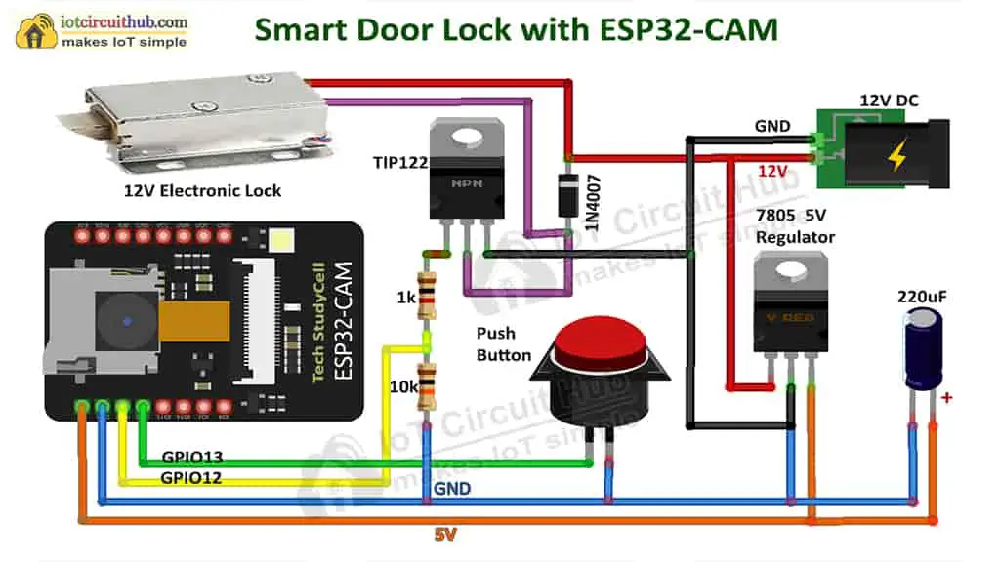
Block Diagram

Slide 5
Methodology
A WIFI door locking system utilizing ESP32-CAM and a Telegram bot enables remote door control. ESP32-CAM captures images, processes commands received via Telegram bot, allowing users to lock/unlock doors remotely. This innovative system ensures secure and convenient access management via smartphone, enhancing home security. Additionally, the system integrates real-time notifications, providing users with alerts and images of door activities. It offers seamless integration with existing home automation setups, enhancing overall smart home functionality. The use of ESP32-CAM and Telegram bot ensures a cost-effective and user-friendly solution for remote door access and monitoring, making it an ideal choice for modern security applications.

Slide 6
Connections
To create a WiFi door locking system, connect the ESP32-CAM's VCC and GND to the 5V output and ground, respectively, of the 7805 regulator. Utilize a TIP122 NPN transistor to control the 12V electronic lock, connecting its collector to the lock's positive terminal and emitter to ground, with the base connected to a digital pin through a 1k resistor. Power the system with a 12V DC supply and ensure proper voltage regulation using a 1N4007 diode and a 100uF capacitor. Incorporate a push switch, connecting one terminal to a digital pin and the other to the ground, for manual control. These connections enable secure remote door access using ESP32-CAM and a Telegram bot, enhancing home security and convenience. Additionally, integrate the 10k resistor between the base of the TIP122 transistor and the ground to ensure stable operation. Implement proper programming on the ESP32-CAM to capture images upon receiving commands from the Telegram bot. Utilize the 7805 5V regulator to power other 5V components and peripherals, ensuring consistent and reliable performance. Incorporate appropriate safety measures, such as current-limiting resistors and proper insulation, to protect electronic components from voltage fluctuations and short circuits. Regularly test and calibrate the system to maintain its functionality and enhance overall security features, ensuring a robust and dependable WiFi door locking solution.

Slide 7
Result
The implemented WiFi door locking system successfully utilizes the ESP32-CAM board, TIP122 NPN transistor, and other components to enable remote door control. Through secure Telegram bot commands, users can remotely lock and unlock doors. The system ensures seamless integration by regulating voltage using the 7805 5V regulator, enhancing stability. The 12V electronic lock is controlled efficiently using the transistor, triggered by ESP32-CAM's digital signals. The inclusion of a push switch allows manual control for added flexibility. Safety measures, such as current-limiting resistors and proper insulation, are employed, ensuring component protection. Regular testing and calibration validate the system's reliability, ensuring its robustness in enhancing home security and convenience.

Slide 8
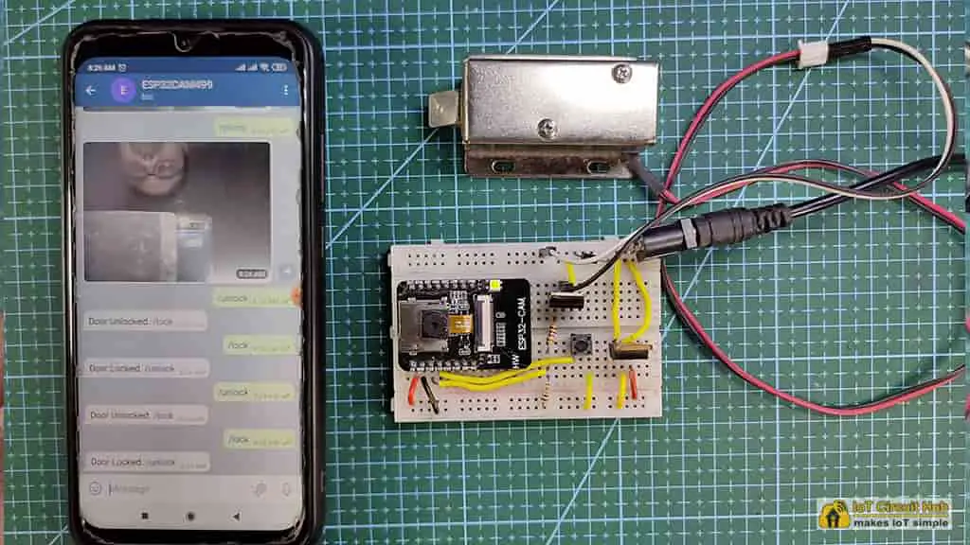
Output

Slide 9
THANK YOU!!!
.

